Slide 1
Using a CNN to interpret molecule complexity from Mass Spectra
JJ Forsyth

Slide 2
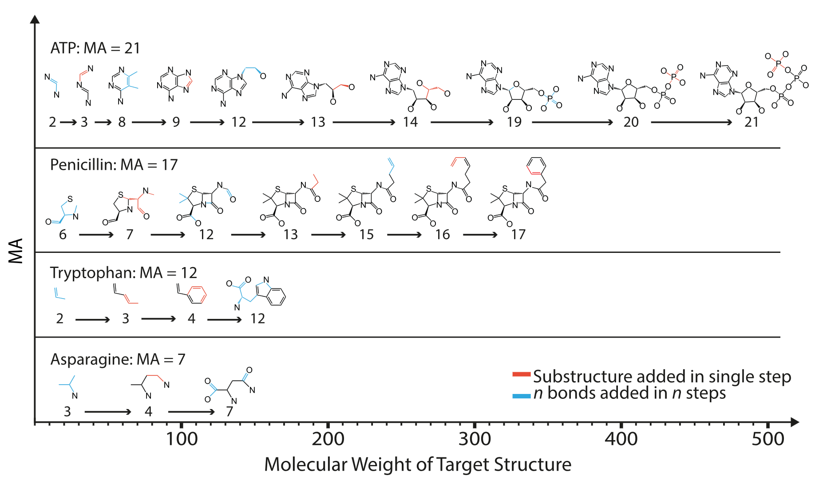
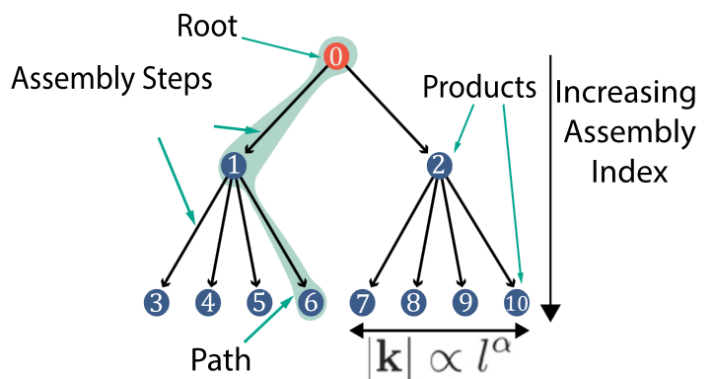
Motivation
The definition of life is complicated and not a consensus amongst biologists
Marshall et al (2021) develop a framework of testing for life based on a samples complexity
Molecular Assembly (MA) – Number of steps required to create an

Slide 3
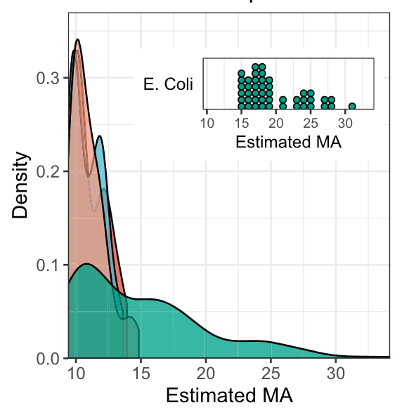
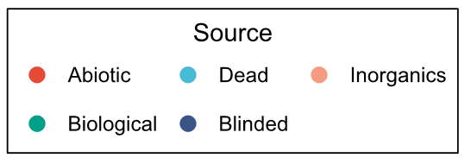
Motivation
Molecules of high complexity are exclusively created in biological systems
Even a simple peptide has high chemical complexity when compared to most compounds
At what level of sample complexity can we conclusively determine a sample is biological?

Slide 4
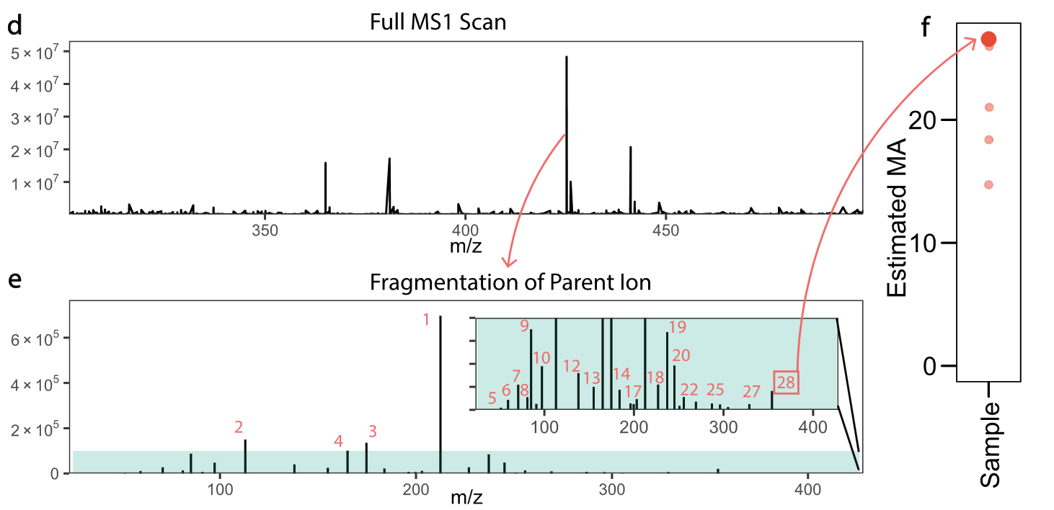
Motivation
Marshall et al (2021) use MS/MS data to calculate the global MA of a sample

Slide 5
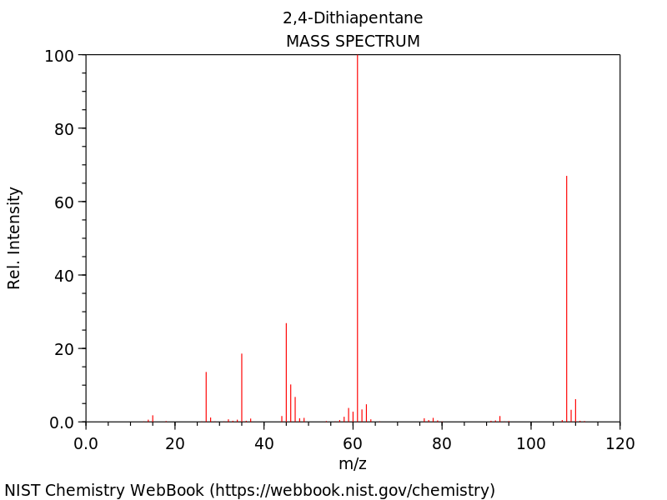
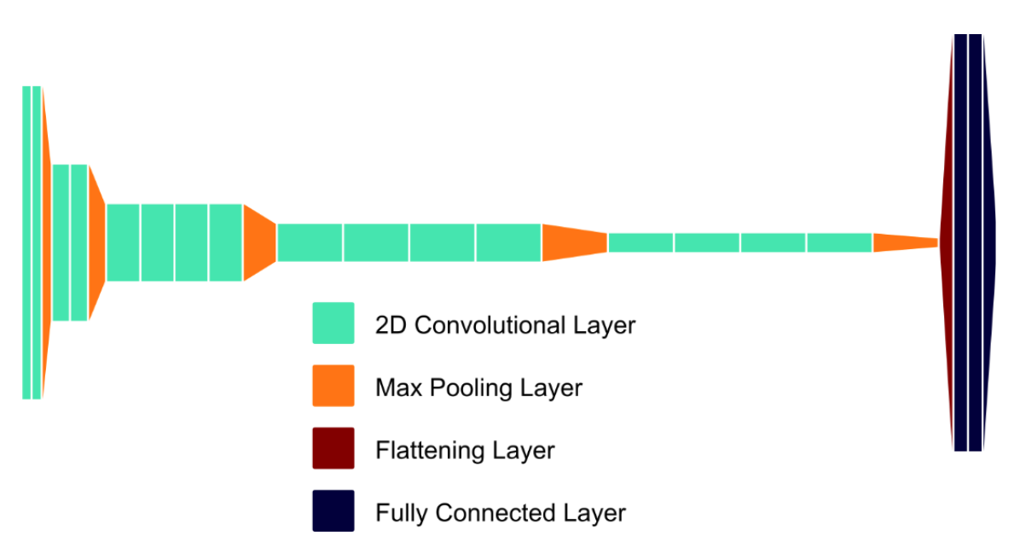
Method
Marshall et al (2021) also develop a supplemental proof-of-concept CNN on identifying MA from MS spectra
Want to build on their CNN framework as it could streamline sample analysis

Slide 6
Experiment outline
MS Data scraped from NIST Webbook
Fed into VGG19 or similar CNN system for classification
‘Score’ to beat
Perfect guess percentage of 48%

Slide 7
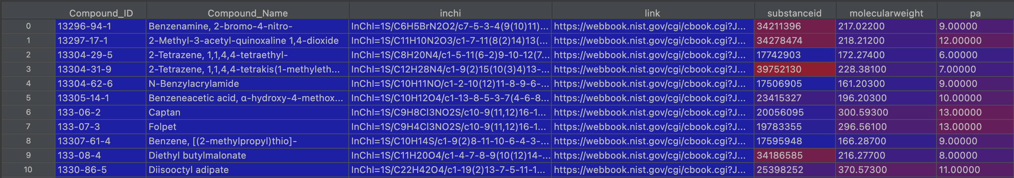

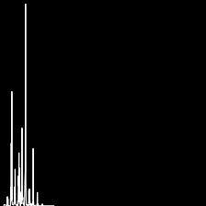
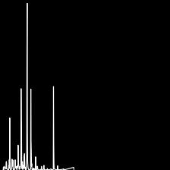
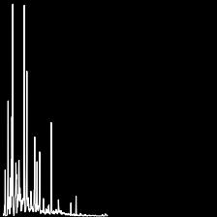
Data Collection
Authors created a .pickle file with 2.5 million MA-labelled compounds
Extracted ~17,000 molecule spectra based on their InChl and overlapped with the authors dataset
Only used ~1500 samples
Images created based on downloaded JCAMP-DX spectra files
1
10
15
20

Slide 8
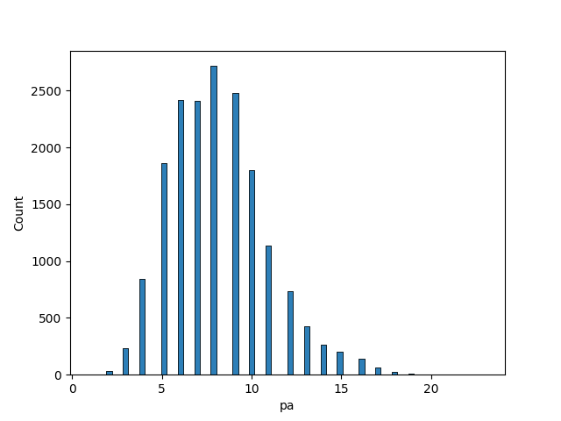
Imbalanced Data
Of the 17,000 sample labels, only 451 have a MA of 15+
For this reason I reduced the inclusion of the lower scored samples
Also used same 451 files for validation (Not ideal)

Slide 9
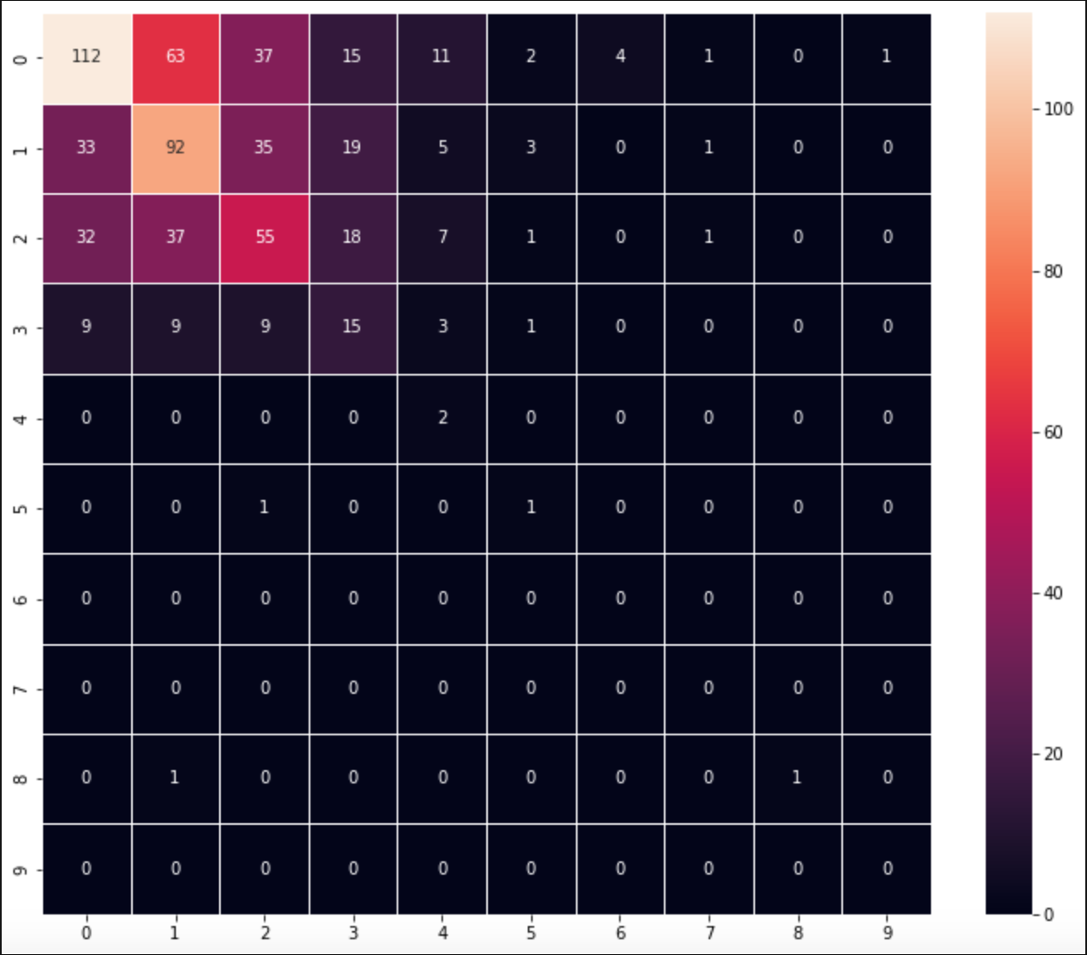
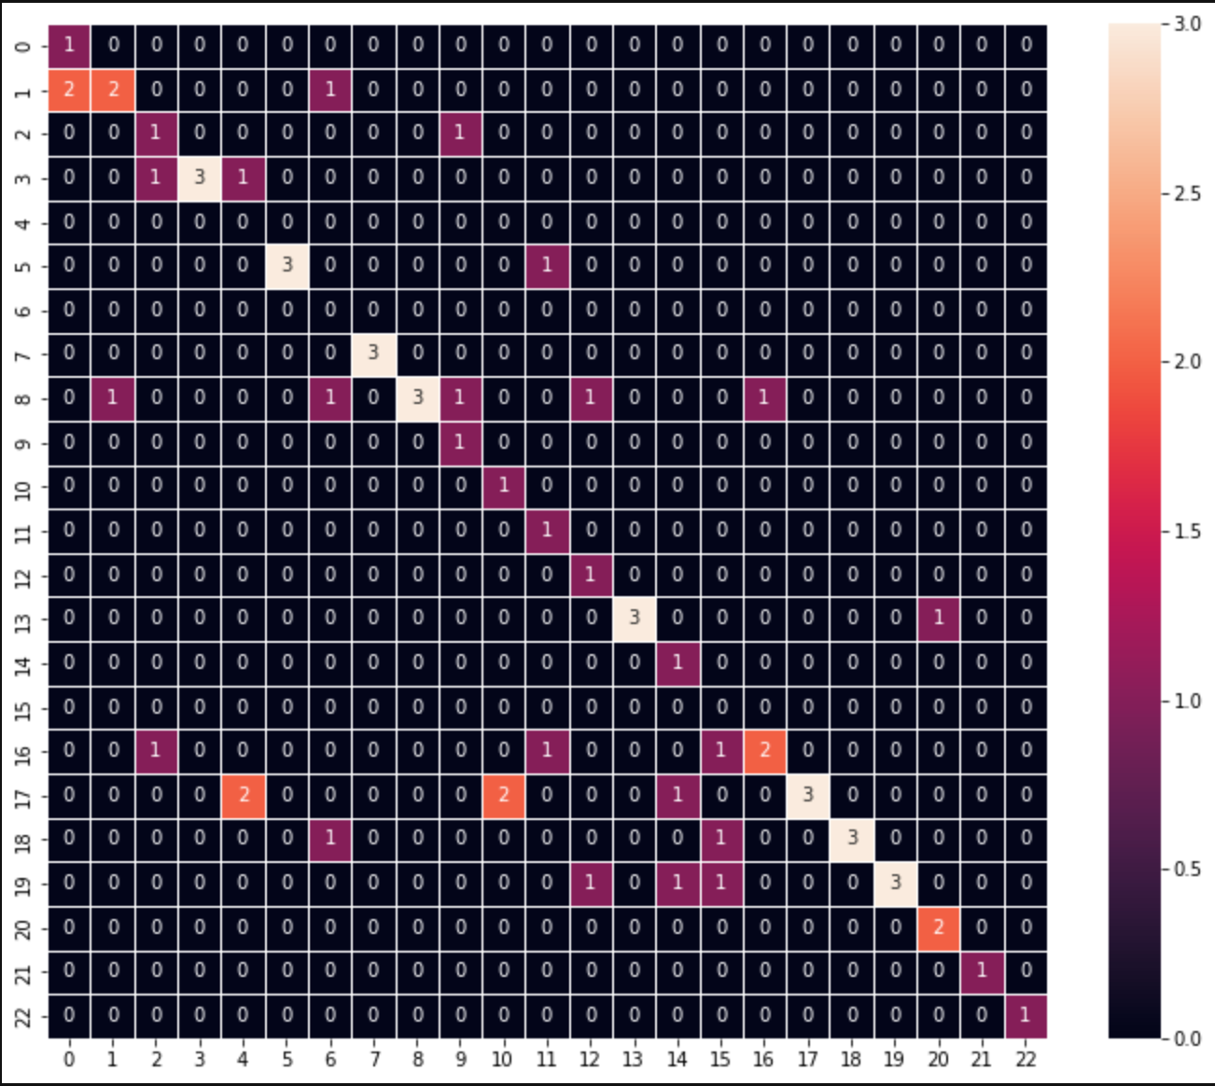
Early results
Had promising early results that assured me this may work at smaller scaled
Actual range here is 14-23

Slide 10
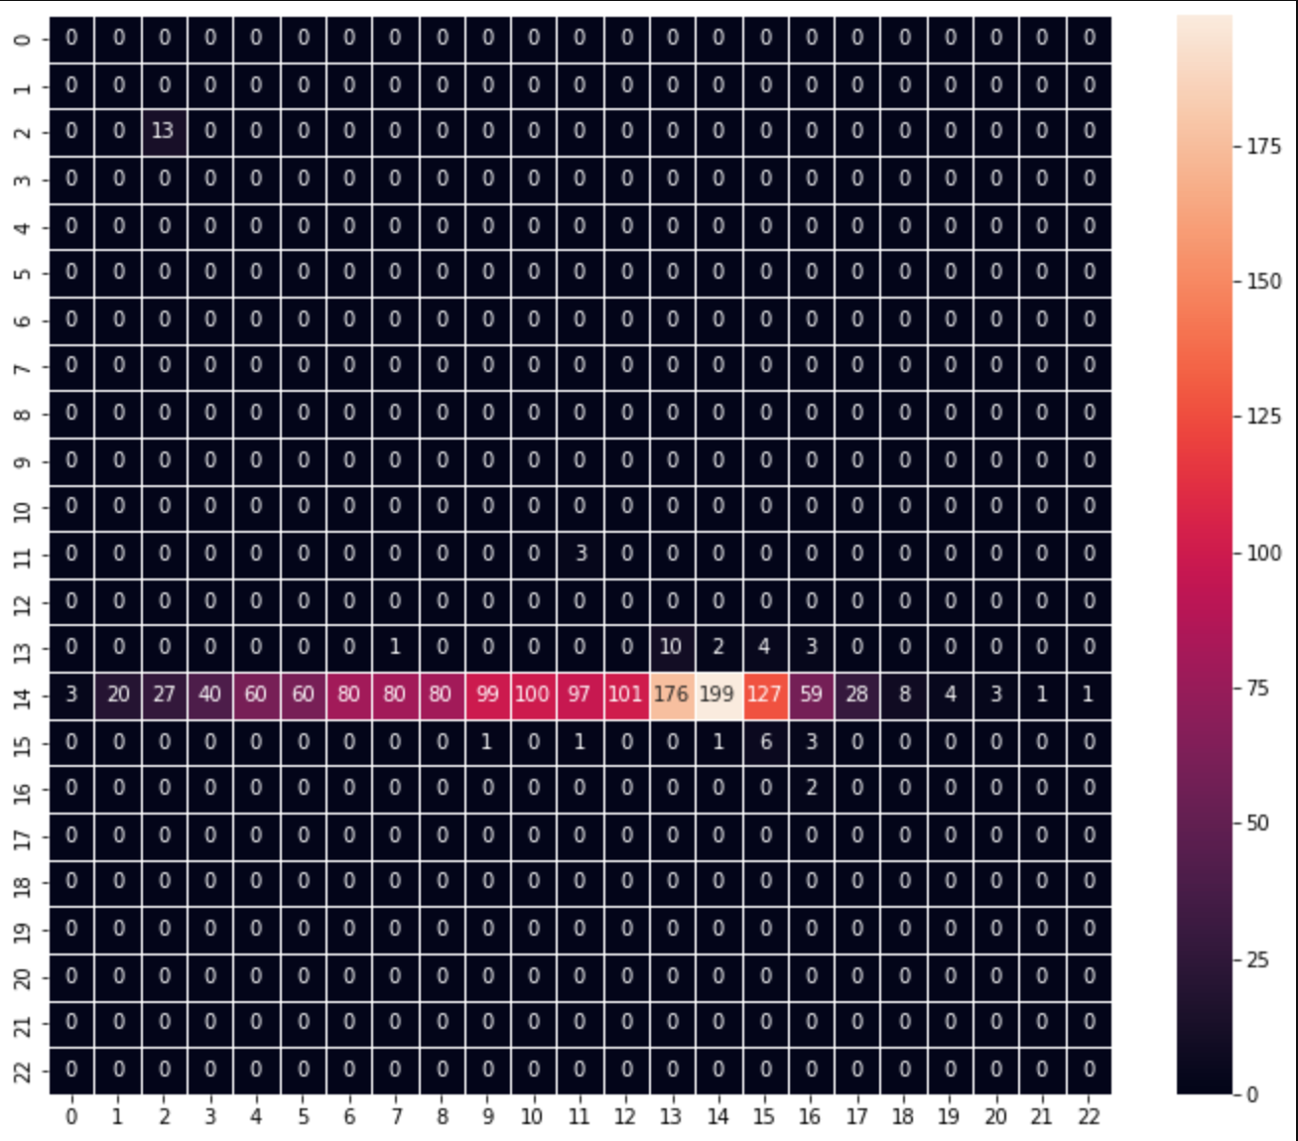
Failed at full scale
Early results did not materialize once I included the full scope of data
Model kept converging and resulting in guessing the same score for each sample
Still not sure why this happened
Maybe too much overlap between samples?
Using the wrong loss formula?
Not enough data?

Slide 11
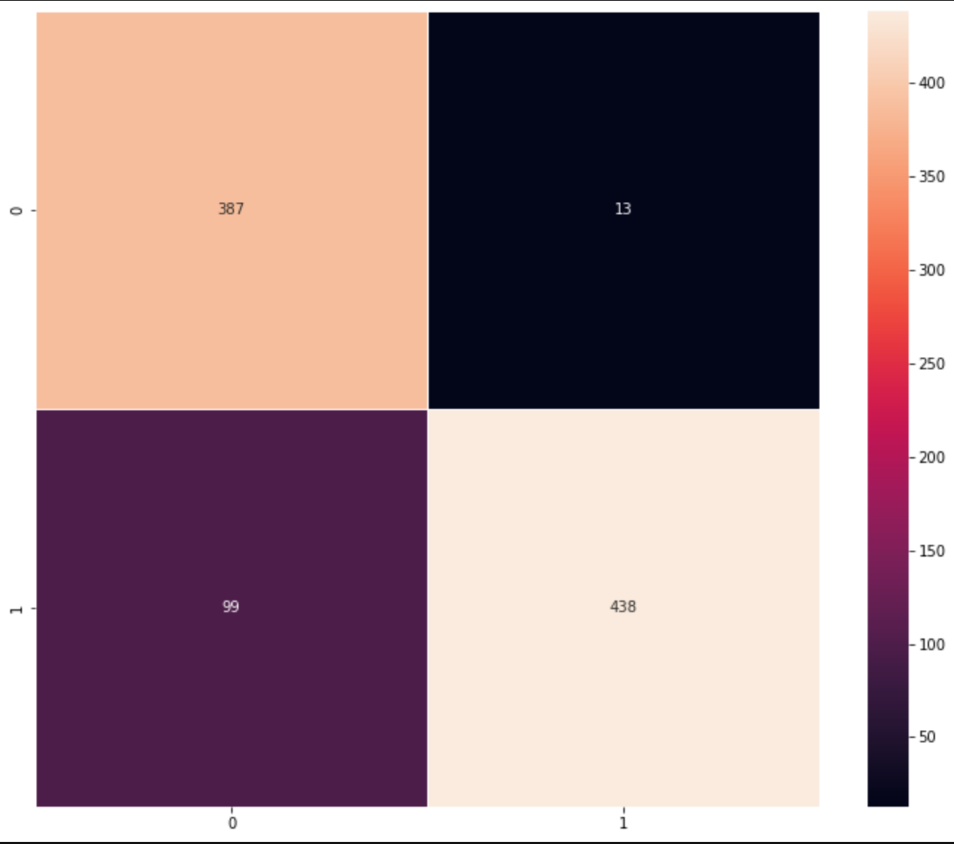
Shifted gears
Decided to reduce complexity of the model
Switched from 23 categories to 2; ‘Living’ (MA>=15), ‘Non-Living’ (MA<15)
Binary Categorical Crossentropy
Data ranges from MA of 10-23
Accuracy of 79%
Not a great False Positive Rate (20%)
Tried to reduce this by increasing weight of negative samples, but ran out of time.
0 = ‘Non-Living’ (<15)
1 = ‘Living’ (>=15)

Slide 12
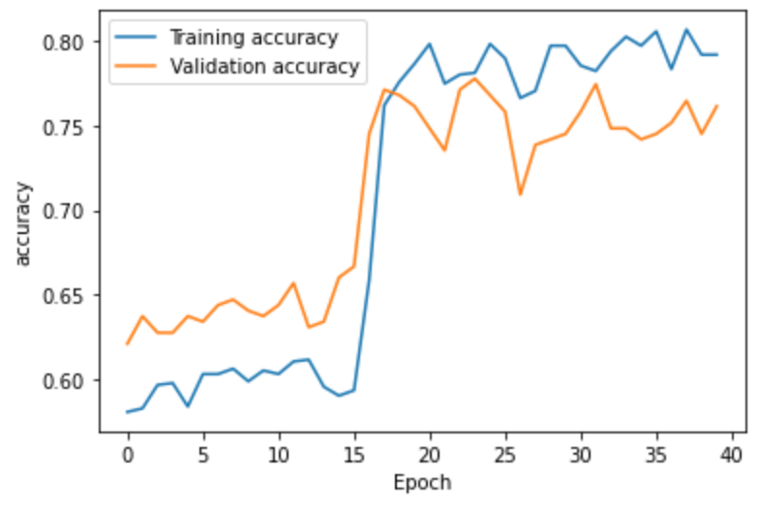
Speculation on failure of original model
+30 for epochs

Slide 13
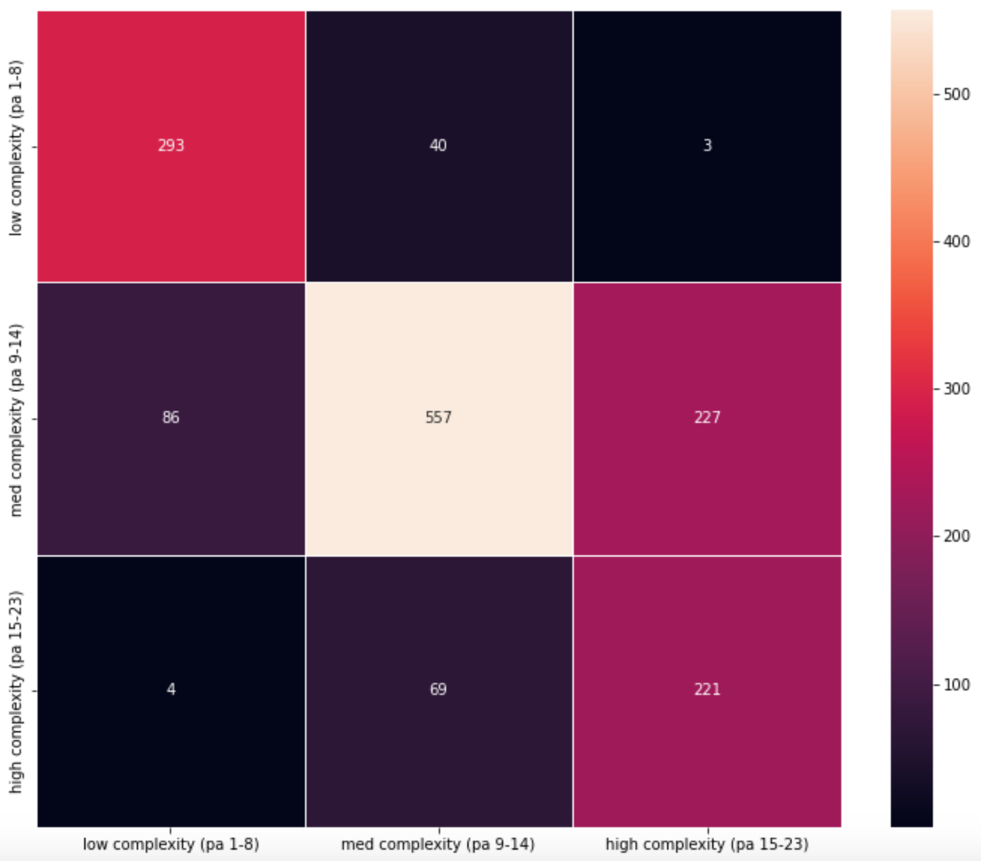
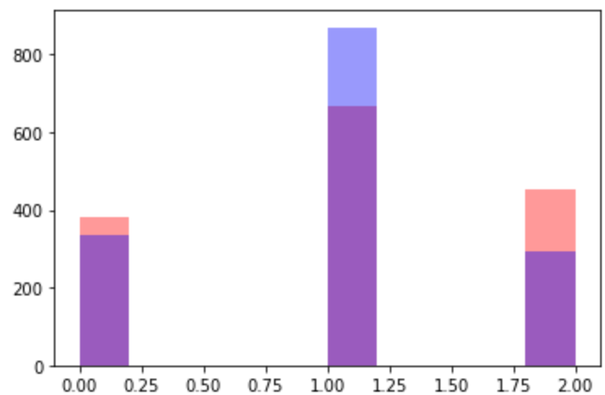
Other results
Tried to reduce categories
Wasn’t trained enough with this to be entirely sure it’s accurate results
Was only able to train for 5 epochs (ran out of time to continue)
Red= label
Blue = predicted

Slide 14
Improving results
Maybe use multiple models;
One to classify overall complexity (low, med, high)
Based on that result it could be fed into a second model that anticipates low OR third model that anticipates medium/high complexity mass spec. data
Further train the models – Some results may have been from impatience
Use more data? Reduced the amount used by a lot.

Slide 15
Thank you!

